Slide 1

Introduction to Probability and Statistics
Twelfth Edition
Robert J. Beaver • Barbara M. Beaver • William Mendenhall
Presentation designed and written by:
Barbara M. Beaver

Slide 2
Introduction to Probability and Statistics
Twelfth Edition
Chapter 5
Several Useful Discrete Distributions
Some graphic screen captures from Seeing Statistics ®
Some images © 2001-(current year) www.arttoday.com

Slide 3
Introduction
Discrete random variables take on only a finite or countably number of values.
Three discrete probability distributions serve as models for a large number of practical applications:
The binomial random variable
The Poisson random variable
The hypergeometric random variable

Slide 4
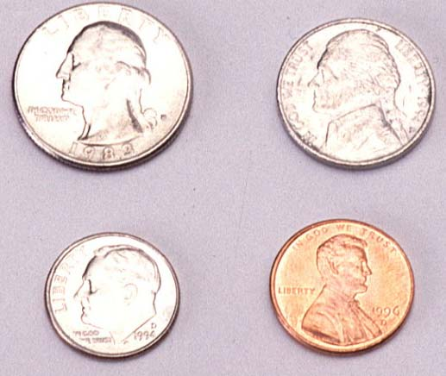
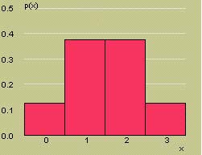
The Binomial Random Variable
The coin-tossing experiment is a simple example of a binomial random variable. Toss a fair coin n = 3 times and record x = number of heads.
x | p(x)
0 | 1/8
1 | 3/8
2 | 3/8
3 | 1/8

Slide 5

The Binomial Random Variable
Many situations in real life resemble the coin toss, but the coin is not necessarily fair, so that P(H) ≠ 1/2.
Example: A geneticist samples 10 people and counts the number who have a gene linked to Alzheimer’s disease.
Coin:
Head:
Tail:
Person
Number of
tosses:
P(H):
n = 10
Has gene
P(has gene) = proportion in the population who have the gene.
Doesn’t have gene

Slide 6
The Binomial Experiment
The experiment consists of n identical trials.
Each trial results in one of two outcomes, success (S) or failure (F).
The probability of success on a single trial is p and remains constant from trial to trial. The probability of failure is q = 1 – p.
The trials are independent.
We are interested in x, the number of successes in n trials.

Slide 7
Binomial or Not?
Very few real life applications satisfy these requirements exactly.
Select two people from the U.S. population, and suppose that 15% of the population has the Alzheimer’s gene.
  For the first person, p = P(gene) = .15
  For the second person, p ≈ P(gene) = .15, even though one person has been removed from the population.

Slide 8
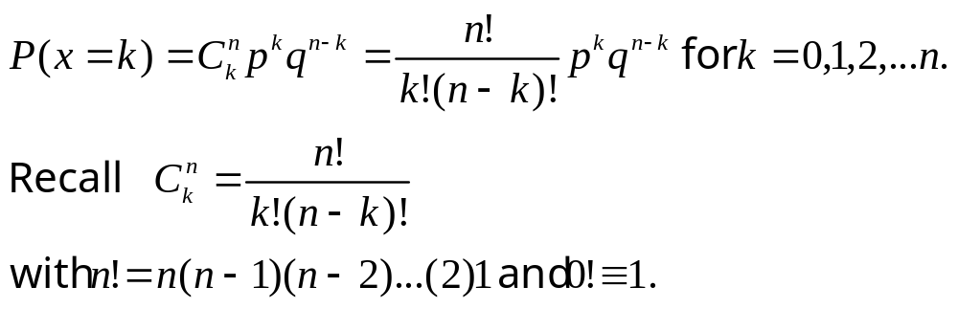
The Binomial Probability Distribution
For a binomial experiment with n trials and probability p of success on a given trial, the probability of k successes in n trials is

Slide 9
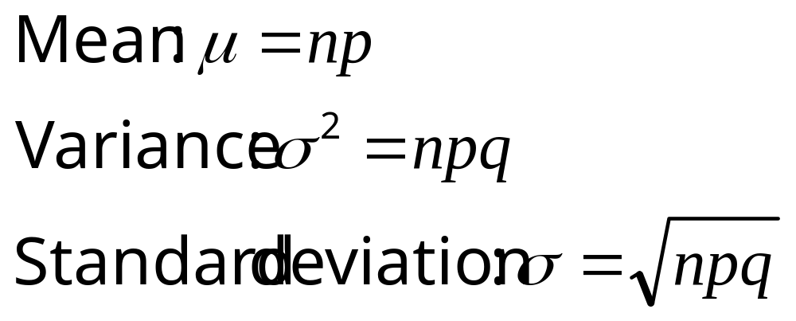
The Mean and Standard Deviation
For a binomial experiment with n trials and probability p of success on a given trial, the measures of center and spread are:

Slide 10

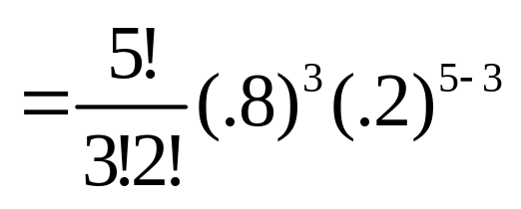
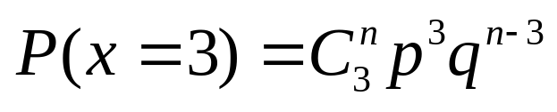
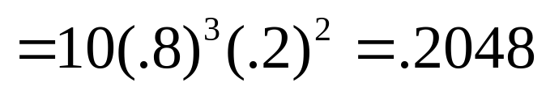
Example
MY
APPLET
A marksman hits a target 80% of the
time. He fires five shots at the target. What is the probability that exactly 3 shots hit the target?
n =
5
hit
p =
.8
x =
# of hits
success =

Slide 11
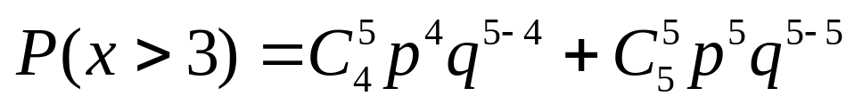
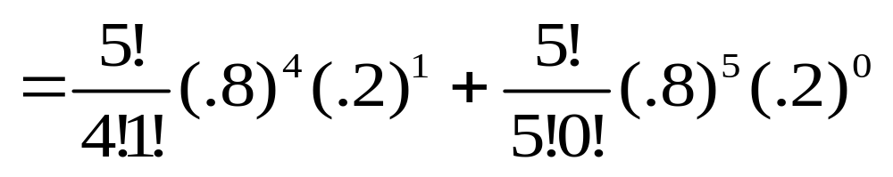
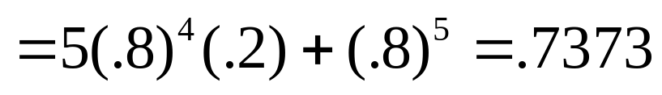
Example
MY
APPLET
What is the probability that more than 3 shots hit the target?

Slide 12
Cumulative Probability Tables
You can use the cumulative probability tables to find probabilities for selected binomial distributions.
Find the table for the correct value of n.
Find the column for the correct value of p.
The row marked “k” gives the cumulative probability, P(x ≤ k) = P(x = 0) +…+ P(x = k)

Slide 13
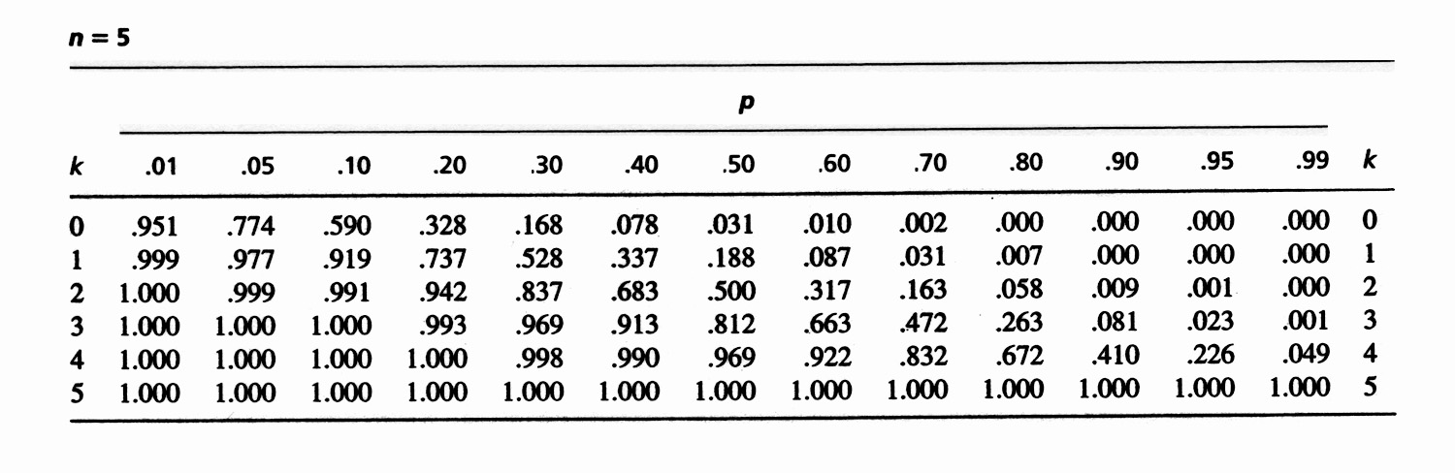
Example
MY
APPLET
k | p = .80
0 | .000
1 | .007
2 | .058
3 | .263
4 | .672
5 | 1.000
What is the probability that exactly 3 shots hit the target?
P(x = 3) = P(x ≤ 3) – P(x ≤ 2)
= .263 - .058
= .205
Check from formula: P(x = 3) = .2048

Slide 14
Example
MY
APPLET
k | p = .80
0 | .000
1 | .007
2 | .058
3 | .263
4 | .672
5 | 1.000
What is the probability that more than 3 shots hit the target?
P(x > 3) = 1 - P(x ≤ 3)
= 1 - .263 = .737
Check from formula: P(x > 3) = .7373

Slide 15
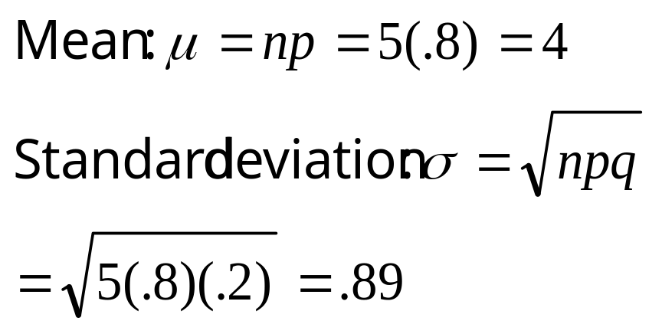
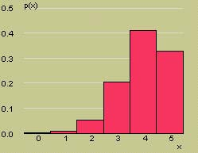
Example
Here is the probability distribution for x = number of hits. What are the mean and standard deviation for x?
μ

Slide 16
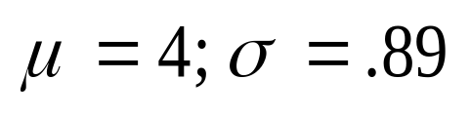
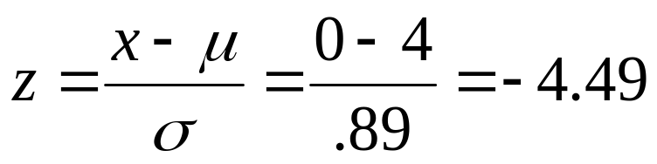
Example
MY
APPLET
Would it be unusual to find that none of the shots hit the target?
The value x = 0 lies
more than 4 standard deviations below the mean. Very unusual.
μ

Slide 17
The Poisson Random Variable
The Poisson random variable x is a model for data that represent the number of occurrences of a specified event in a given unit of time or space.
Examples:
  The number of calls received by a switchboard during a given period of time.
  The number of machine breakdowns in a day
  The number of traffic accidents at a given intersection during a given time period.

Slide 18
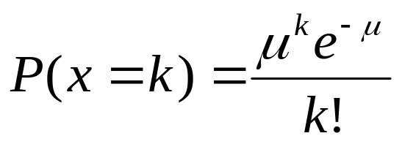

The Poisson Probability
Distribution
x is the number of events that occur in a period of time or space during which an average of μ such events can be expected to occur. The probability of k occurrences of this event is
For values of k = 0, 1, 2, … The mean and standard deviation of the Poisson random variable are
Mean: μ
Standard deviation:

Slide 19

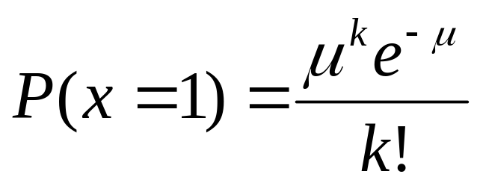
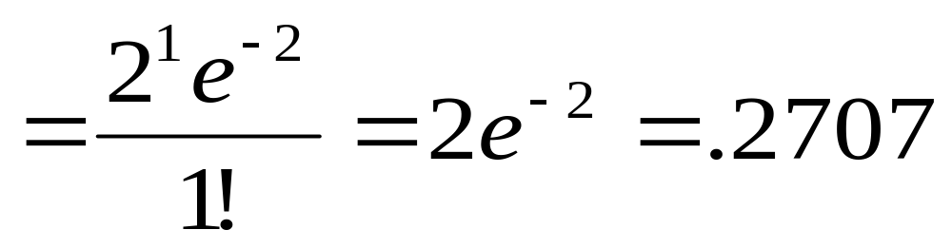
Example
The average number of traffic accidents on a certain section of highway is two per week. Find the probability of exactly one accident during a one-week period.

Slide 20
Cumulative Probability Tables
You can use the cumulative probability tables to find probabilities for selected Poisson distributions.
Find the column for the correct value of μ.
The row marked “k” gives the cumulative probability, P(x ≤ k) = P(x = 0) +…+ P(x = k)

Slide 21
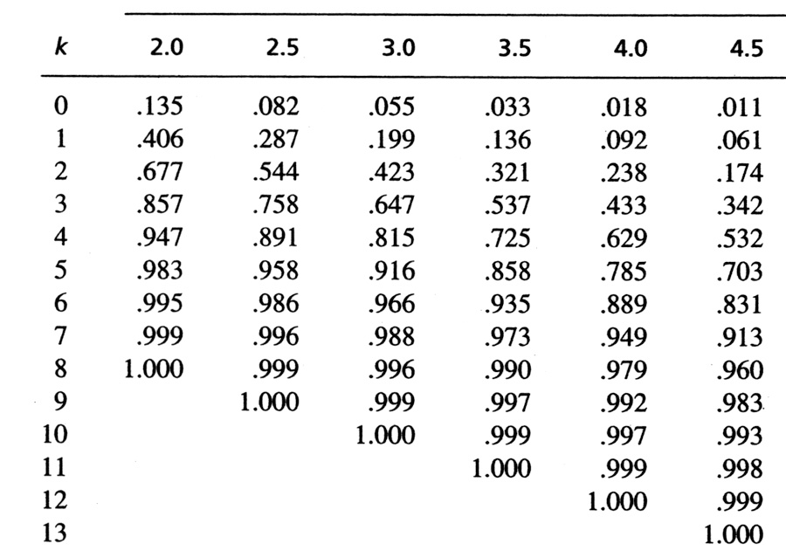
Example
What is the probability that there is exactly 1 accident?
k | μ = 2
0 | .135
1 | .406
2 | .677
3 | .857
4 | .947
5 | .983
6 | .995
7 | .999
8 | 1.000
P(x = 1) = P(x ≤ 1) – P(x ≤ 0)
= .406 - .135
= .271
Check from formula: P(x = 1) = .2707

Slide 22
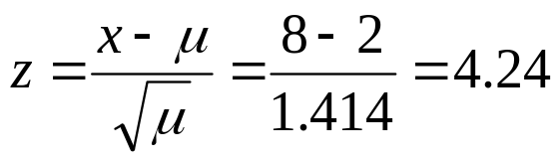
Example
k | μ = 2
0 | .135
1 | .406
2 | .677
3 | .857
4 | .947
5 | .983
6 | .995
7 | .999
8 | 1.000
What is the probability that 8 or more accidents happen?
P(x ≥ 8) = 1 - P(x < 8)
= 1 – P(x ≤ 7)
= 1 - .999 = .001
This would be very unusual (small probability) since x = 8 lies
standard deviations above the mean.

Slide 23
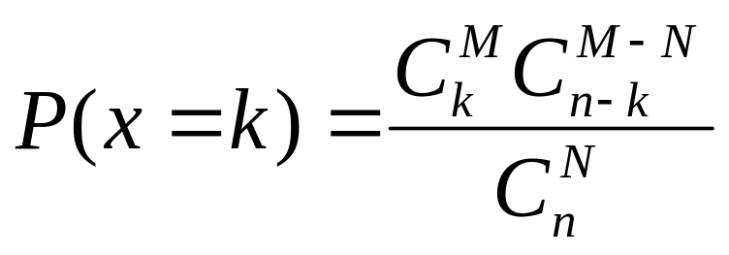
The Hypergeometric Probability Distribution
m
m
m
m
m
m
m
The “M&M® problems” from Chapter 4 are modeled by the hypergeometric distribution.
A bowl contains M red candies and N-M blue candies. Select n candies from the bowl and record x the number of red candies selected. Define a “red M&M®” to be a “success”.
The probability of exactly k successes in n trials is

Slide 24
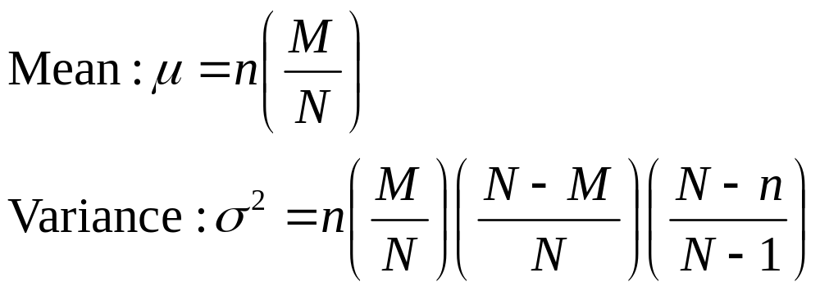
The Mean and Variance
m
m
m
m
m
m
m
The mean and variance of the hypergeometric random variable x resemble the mean and variance of the binomial random variable:

Slide 25

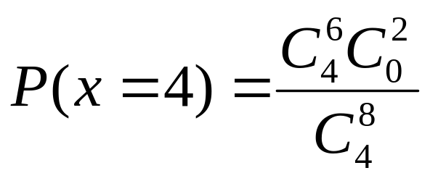
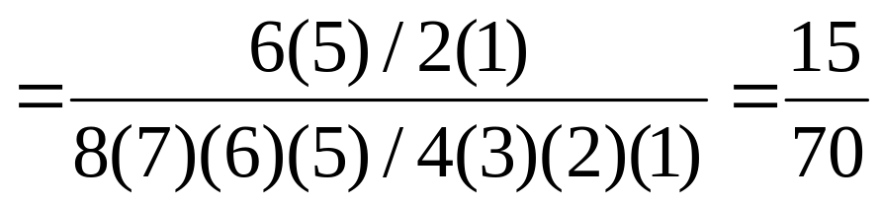
Example
A package of 8 AA batteries contains 2 batteries that are defective. A student randomly selects four batteries and replaces the batteries in his calculator. What is the probability that all four batteries work?
Success = working battery
N = 8
M = 6
n = 4

Slide 26
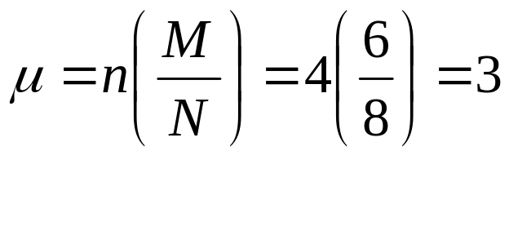
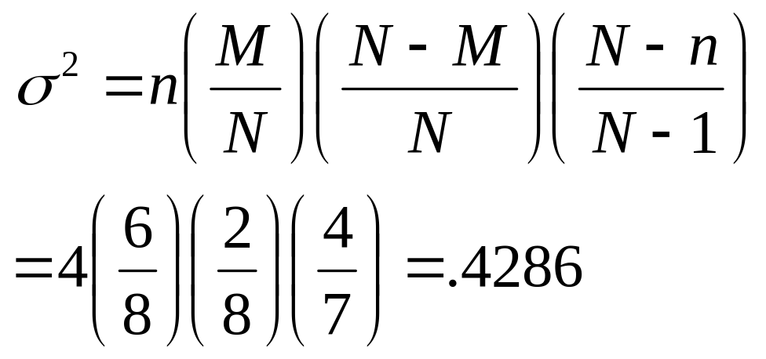
Example
What are the mean and variance for the number of batteries that work?

Slide 27
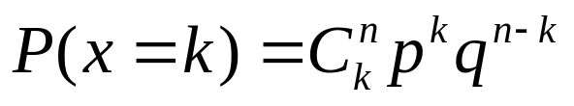

Key Concepts
I. The Binomial Random Variable
1. Five characteristics: n identical independent trials, each resulting in either success S or failure F; probability of success is p and remains constant from trial to trial; and x is the number of successes in n trials.
2. Calculating binomial probabilities
a. Formula:
b. Cumulative binomial tables
c. Individual and cumulative probabilities using Minitab
3. Mean of the binomial random variable: μ = np
4. Variance and standard deviation: σ ² = npq and

Slide 28
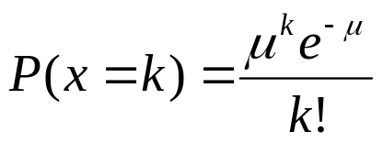
Key Concepts
II. The Poisson Random Variable
1. The number of events that occur in a period of time or space, during which an average of μ such events are expected to occur
2. Calculating Poisson probabilities
a. Formula:
b. Cumulative Poisson tables
c. Individual and cumulative probabilities using Minitab
3. Mean of the Poisson random variable: E(x) = μ
4. Variance and standard deviation: σ ² = μ and
5. Binomial probabilities can be approximated with Poisson probabilities when np < 7, using μ = np.

Slide 29

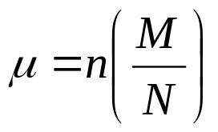
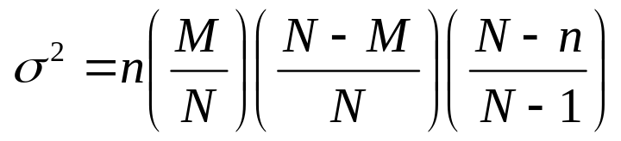
Key Concepts
III. The Hypergeometric Random Variable
1. The number of successes in a sample of size n from a finite
population containing M successes and N − M failures
2. Formula for the probability of k successes in n trials:
3. Mean of the hypergeometric random variable:
4. Variance and standard deviation:

